Slide 1
Lecture Contents
Introduction to Solar Energy
Solar Energy Potential
Nature of Solar Radiations
Geometry of Earth and Sun

Slide 2
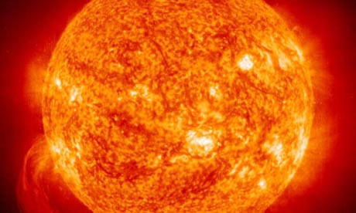
Introduction to Solar Energy
Each second, the sun turns more than four million tonnes of its own mass – mostly hydrogen and helium – into energy.
Theoretical : 1.76 x 10¹⁷ TW striking Earth; 0.3 Global mean albedo
Practical: 600 TW
Conversion Efficiency: 10%
Electricity generation potential = 60 TW
Estimated Global Demand in 2050 = 20 TW

Slide 3
Introduction to Solar Energy
Two primary types of Solar Energy
Solar Thermal
Direct Conversion to electricity (Solar PV)
Solar power is more expensive and its overall contribution is less than that of wind.
Produced only during daylight hours when electricity demand is highest, reducing the need for peaking generators.

Slide 4
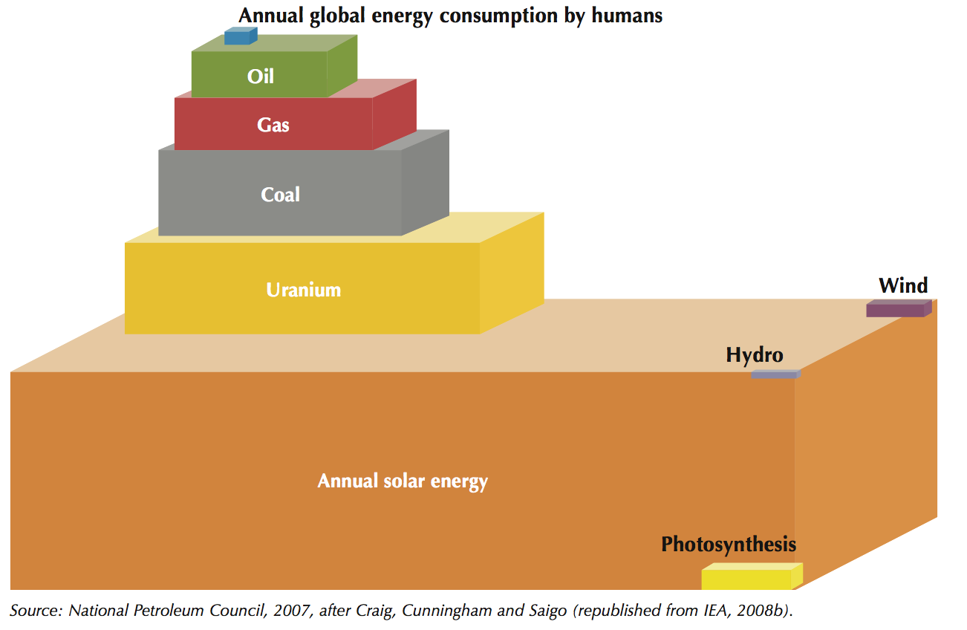
Energy Potential of Available Energy Resources

Slide 5
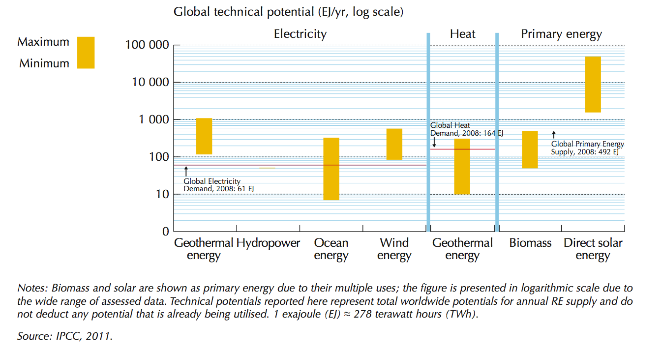
Global Technical Potential of Energy

Slide 6
Solar Energy Potential
Availability - Higher in warm and sunny countries, (where most of the growth – population, economy, and energy demand – will take place in this century)
These countries will have approx. 7 billion inhabitants by 2050, versus 2 billion in cold and temperate countries (including most of Europe, Russia and parts of China and the United States).
Source : IPCC, 2009

Slide 7
Solar Energy Potential
Currently sun takes 1hr & 25 minutes to send us the amount of energy we currently consume in a year, and approx. 4.5hrs to send the same amount of energy only on land.
By 2035, > 2hrs for overall planet and less than 7hrs on land.
A comparison focused on final energy demand would significantly reduce these numbers – to 1hr of sunshine on the whole planet or 3.25 hrs on land today, and by 2035 1.5hr or 4.75 hrs.
Source: IEA, 2011

Slide 8
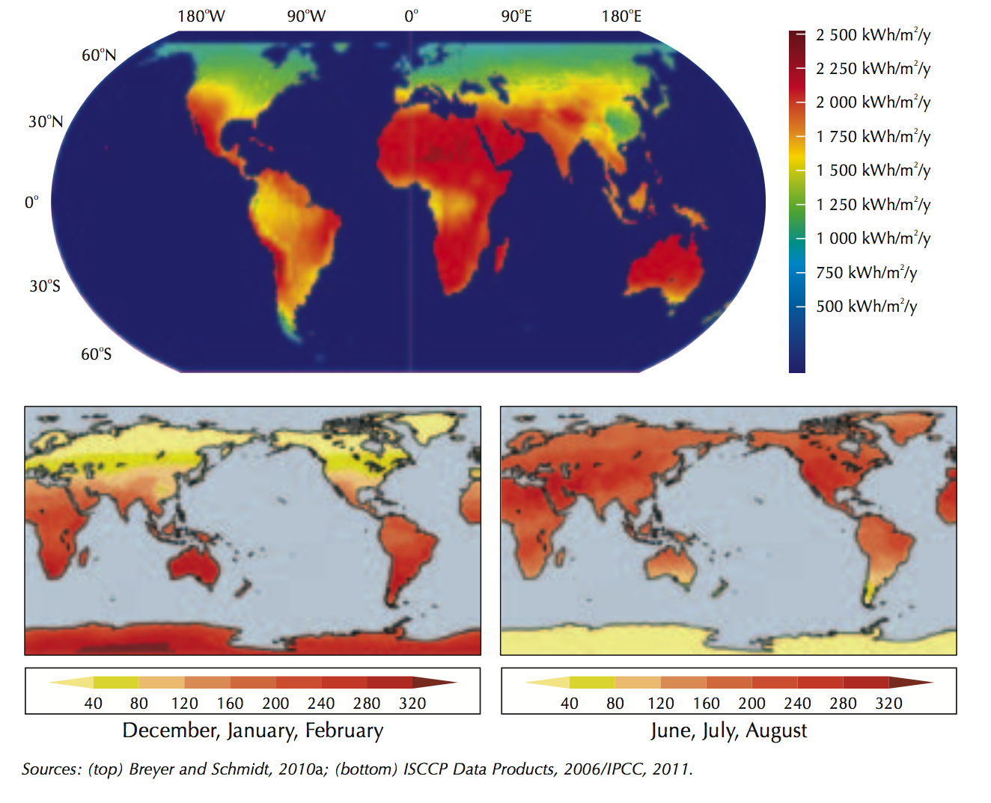

Slide 9
Solar Radiation
Incoming energy received from the sun, averaged over the year and over the surface area of the globe, is one fourth of solar constant i.e. 342 W/m^{2.}
77 W/m² are reflected back to space by clouds, aerosols and the atmosphere,
67 W/m² are absorbed by the atmosphere.
198 W/m², i.e. about 57% of the total, hits the earth’s surface (on average).
Notes:
Our planet is a kind of rotating ball. The surface area of a globe is four times the surface area of a same-diameter disk.

Slide 10
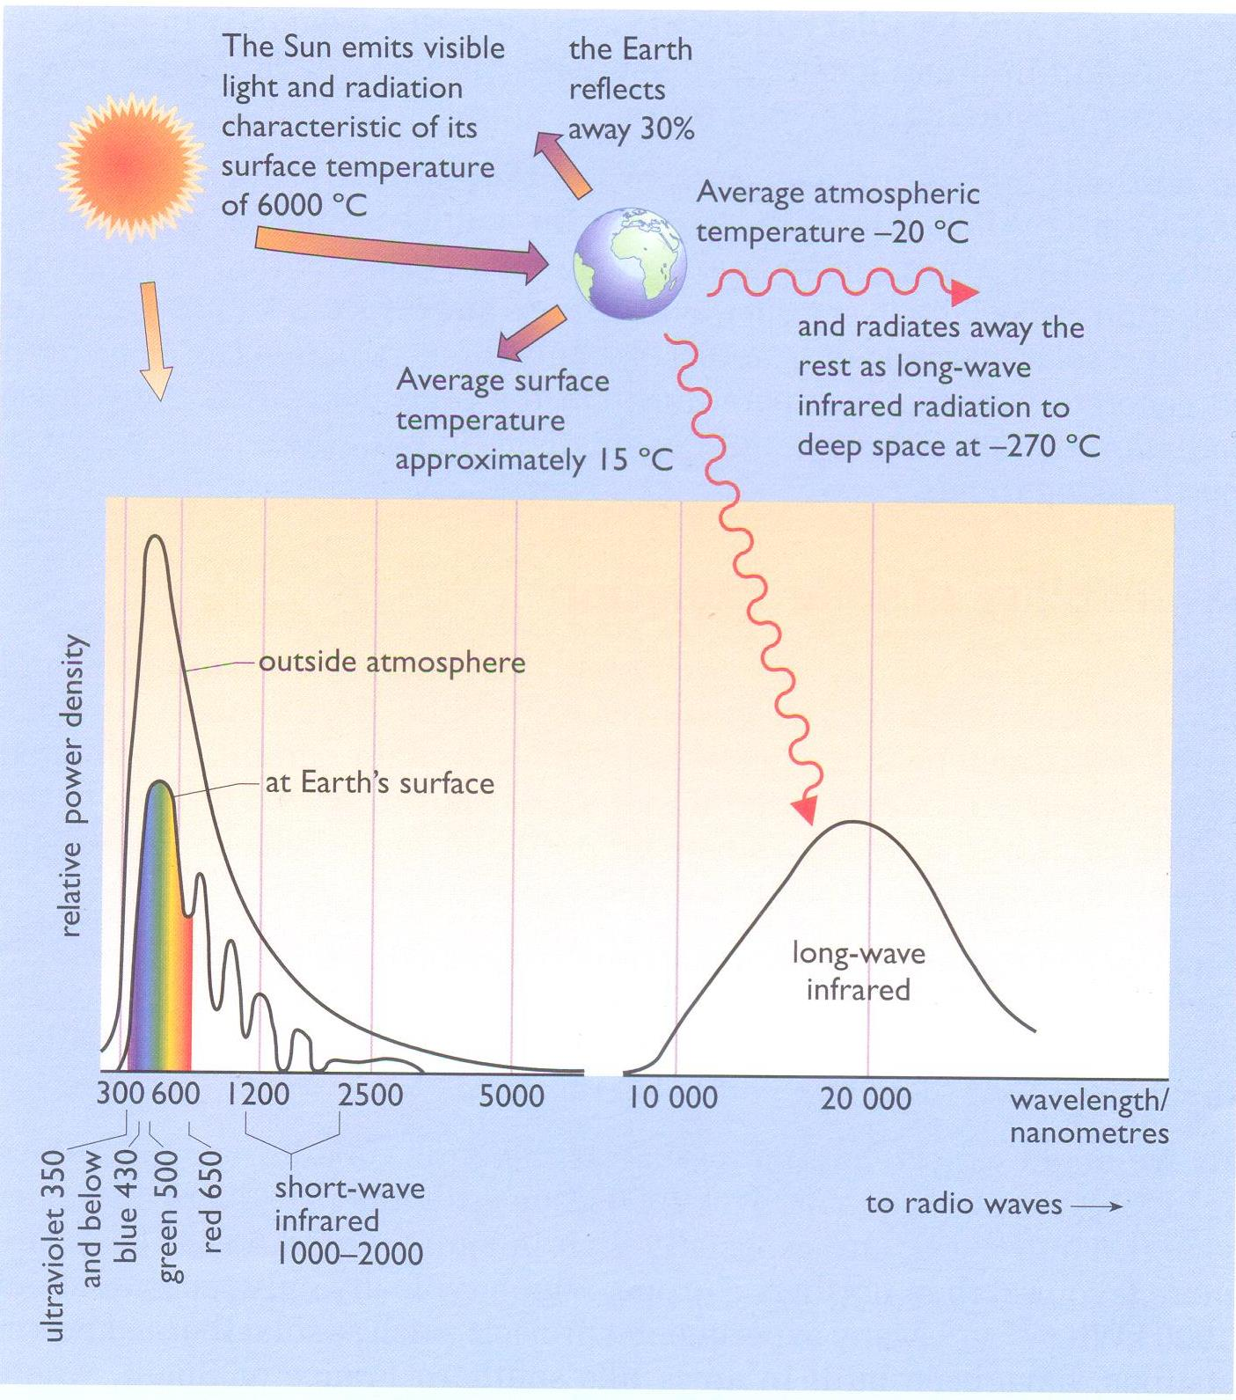
Solar Radiation

Slide 11
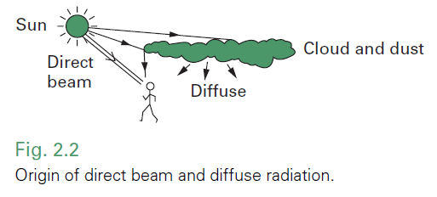
Components of Solar Radiation
Beam Radiation/Direct Radiation
only beam radiation can be focused.
Diffused Radiation/Indirect Radiation/Scattered Radiation
scattered due to combination of aerosols, clouds, dust etc.
For any solar device one may also account for a third component – the diffuse radiation reflected by ground surfaces.
Beam irradiance/Total Irraidance = Ranges from 0.9 -0
Notes:
The ratio between the beam irradiance and the total irradiance thus varies from about 0.9 on a clear day to zero on a completely overcast day.

Slide 12
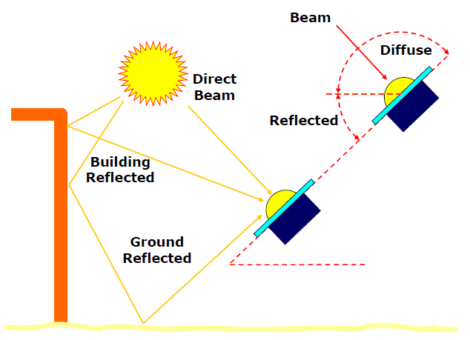
Components of Solar Radiation
Diffuse Radiation: The solar radiation received from the sun after its direction has been changed by scattering by the atmosphere.
Notes:
The ratio between the beam irradiance and the total irradiance thus varies from about 0.9 on a clear day to zero on a completely overcast day.

Slide 13
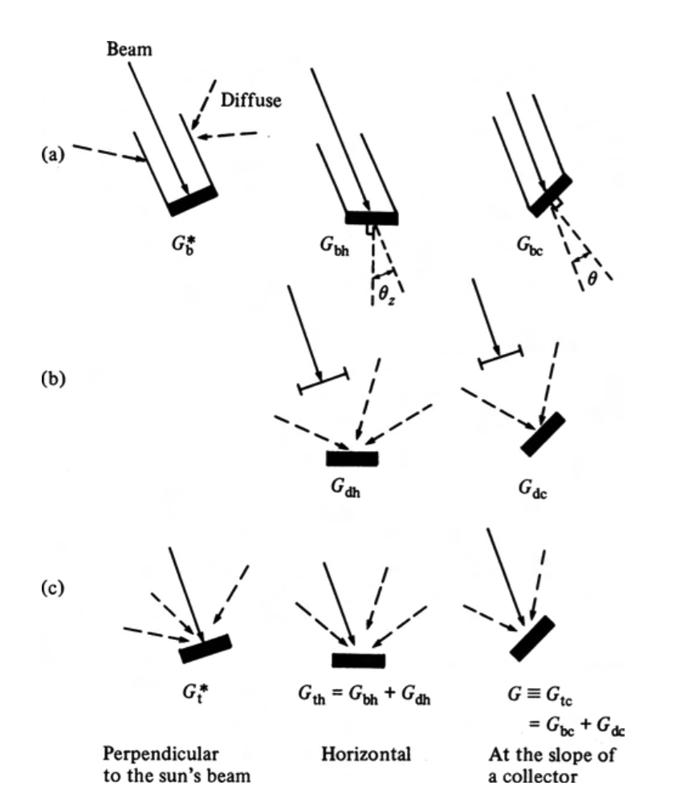
Components of Solar Radiation
where θ is the angle between the beam and the normal to the collector surface.
^{θ}z is the (solar) zenith angle between the beam and the vertical

Slide 14
Irradiation & Irradiance
Irradiance is the rate at which radiant energy is incident on a surface per unit area of surface. It is given in W/m² and is represented by the symbol G.
Irradiation is the incident energy per unit area on a surface - determined by integration of irradiance over a specified time, usually an hour or a day. It is given in J/m²
Insolation is a term used for solar energy irradiation
Radiosity is the rate at which radiant energy leaves a surface, per unit area, by combined emission, reflection and transmission.

Slide 15
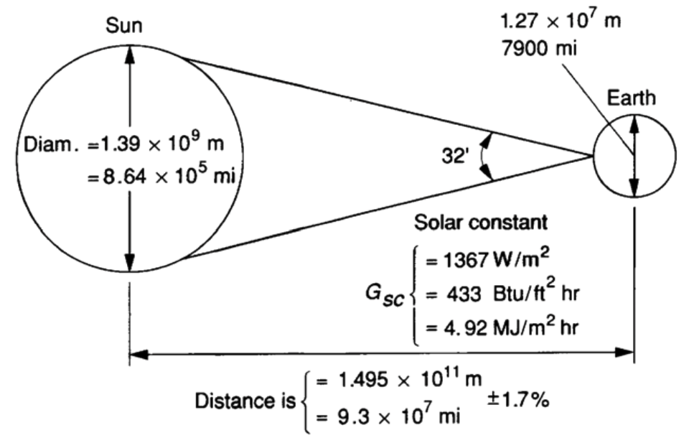
Relationship of Sun & Earth
The solar constant, G_{SC} is the energy from the sun, per unit time, received on a unit area of surface perpendicular to the direction of propagation of the radiation, at mean earth-sun distance, outside of the atmosphere.

Slide 16
Extra terrestrial solar radiation
The amount of extraterrestrial radiation reaching the earth is given by
R_{av} : the mean sun-earth distance
R: the actual sun-earth distance on the day of the year
(R_{av} / R)² = 1.00011+ 0.034221 * cos (b) + 0.001280 * sin (b) + 0.000719 * cos (2b) +0.000077 * sin (2b)
b = 2π (d_{n}-1) / 365 radians and d_{n} is the day of the year

Slide 17
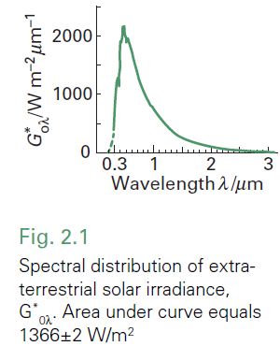
Extra terrestrial solar radiation
The area beneath this curve is the solar constant G0* = 1366 ±2 W/m². This is the radiant flux density (RFD) incident on a plane directly facing the Sun and outside the Earth’s atmosphere at a distance of 1.496 × 108 km from the Sun (i.e. at
the Earth’s mean distance from the Sun).

Slide 18
Extra terrestrial solar radiation
2.4
2.2
2.0
Spectral power distribution of 6000K blackbody
1.8
Actual Spectral power distribution of the sun
1.6
1.4
Energy distribution (kW/m²/μm)
1.2
1.0
0.8
0.6
0.4
0.2
0.0
0.0
0.2
0.4
0.6
0.8
1.0
1.2
1.4
1.6
1.8
2.0
Wavelength (μm⁻¹)

Slide 19
Extra terrestrial solar radiation
The proportions given above are as received at the Earth’s surface with the Sun incident at about 45 degrees.

Slide 20
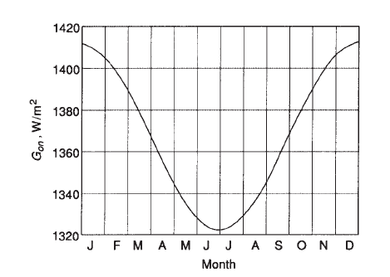
Extra terrestrial solar radiation
Variation in the radiation emitted by the sun.
Variation of the earth-sun distance.
For engineering purposes, in view of the uncertainties and variability of atmospheric transmission, the energy emitted by the sun can be considered to be fixed.

Slide 21
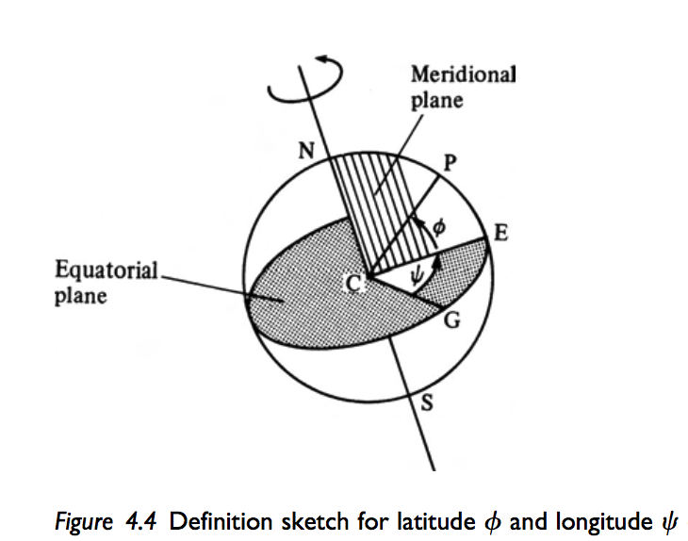
Geometry of Earth and Sun
Latitude is defined positive for points north of the equator, negative south of the equator
Longitude is measured positive eastwards from Greenwich, England.
The vertical north– south
plane through P is the local
meridional plane.

Slide 22
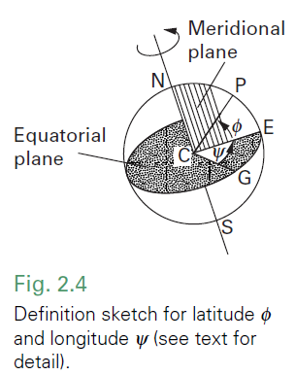
Geometry of Earth and Sun
The point P on the Earth’s surface is determined by its latitude ϕ and longitude; ϕ is positive for points north of the Equator, negative south of the Equator. By international agreement, Ψ is measured positive eastwards from Greenwich, England

Slide 23
Geometry of Earth and Sun
Latitude and Longitude)

Slide 24
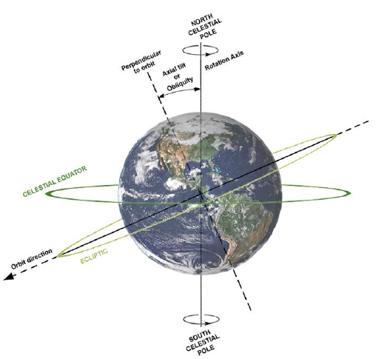
Geometry of Earth and Sun

Slide 25
Geometry of Earth and Sun

Slide 26
Geometry of Earth and Sun
(Declination angle)
The Earth’s daily rotation about the axis through its two celestial poles (North and South) is perpendicular to the equator, but it is not perpendicular to the plane of the Earth’s orbit. In fact, the measure of tilt or obliquity of the Earth’s axis to a line perpendicular to the plane of its orbit is currently about 23.5°.

Slide 27
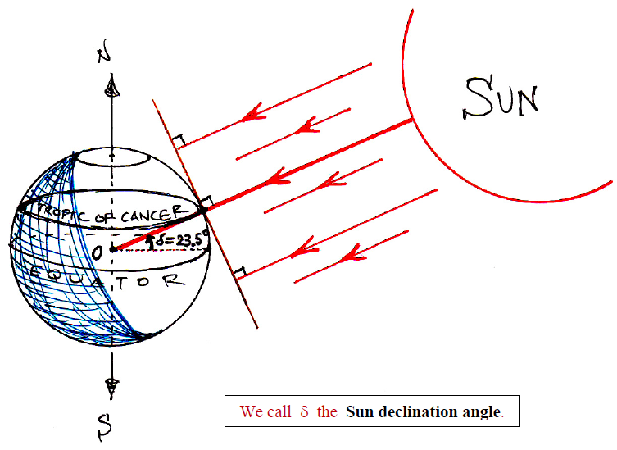
Geometry of Earth and Sun
(Declination angle)
The Sun declination angle, is defined to be that angle made between a ray of the Sun, when extended to the center of the earth, O, and the equatorial plane.
We take δ to be positively oriented whenever the Sun’s rays reach O by passing through the Northern hemisphere

Slide 28
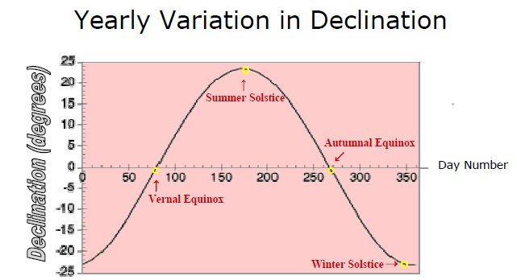
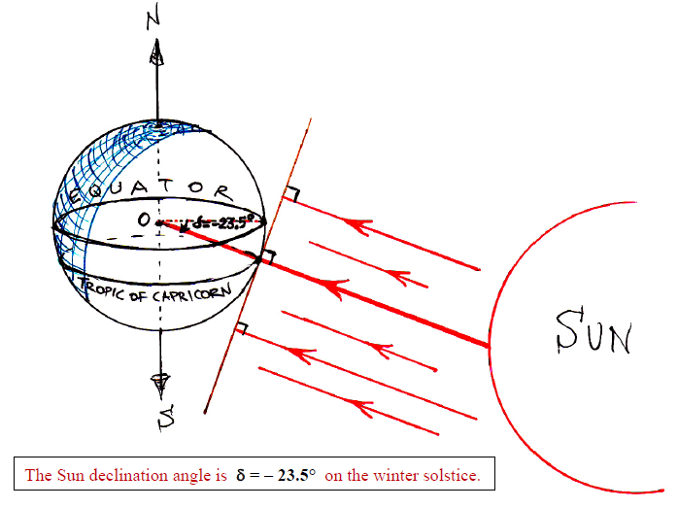
Geometry of Earth and Sun
(Declination angle)

Slide 29
Geometry of Earth and Sun
(Declination angle)
The Earth is above the plane of the Sun during its motion from the autumnal equinox to winter solstice to vernal equinox. Hence, δ < 0 during the fall and winter.
The Earth is below the plane of the sun as it moves from vernal equinox to summer solstice and back to autumnal equinox (i.e. during spring and summer). So δ > 0 during these seasons.

Slide 30
Geometry of Earth and Sun
Solar hour angle
Solar Time based on the apparent angular motion of the sun across the sky with solar noon the time the sun crosses the meridian of the observer.
Solar Noon is defined to be that time of day at which the Sun’s rays are directed perpendicular to a given line of longitude. Thus, solar noon occurs at the same instant for all locations along any common line of longitude.
Solar Noon will occur one hour earlier for every 15 degrees of longitude to the east of a given line and one hour later for every 15 degrees west. (This is because it takes the Earth 24 hours to rotate 360°.)

Slide 31
Geometry of Earth and Sun
Solar hour angle
The hour angle ω at P is the angle through which the Earth has rotated since solar noon. Since the Earth rotates (360°/24h) = 15°/h, the hour angle is given by:
where t_{solar} and t_{zone} are respectively the local solar and civil times (measured in hours), Ψ_{zone} is the longitude where the Sun is overhead when t_{zone} is noon (i.e. where solar time and civil time coincide). ω is positive in the evening and negative in the morning.

Slide 32
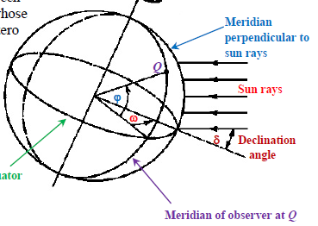
Geometry of Earth and Sun
Hour Angle
The hour angle, ω, is the angular distance between the meridian of the observer and the meridian whose plane contains the sun. Thus, the hour angle is zero at local noon (when the sun reaches its highest point in the sky). The hour angle increases by 15 degrees every hour.

Slide 33
Geometry of Earth and Sun
To convert standard time to solar time by applying two corrections. First, there is a constant correction for the difference in longitude between the observer’s meridian (longitude) and the meridian on which the local standard time is based. The sun takes 4 min to transverse 1◦ of longitude. The second correction is from the equation of time, which takes into account the perturbations in the earth’s rate of rotation which affect the time the sun crosses the observer’s meridian. The difference in minutes between solar time and standard time is

Slide 34
Geometry of Earth and Sun
For Lahore (longitude 74.329) what will be the solar time corresponding to 11 AM on PST on 6th March.

Slide 35
Geometry of Earth and Sun

Slide 36
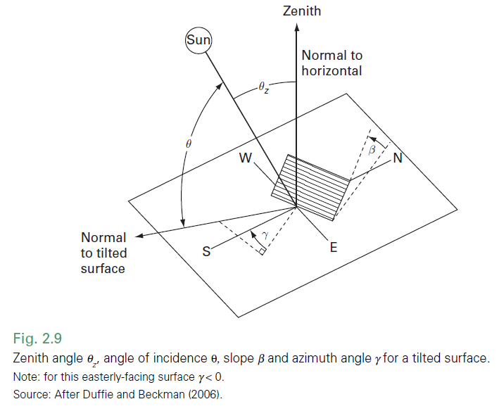
Geometry of Earth and Sun
Collector, Slope, Azimuth and incidence angle)
Slope β: the angle between the plane surface in question and the horizontal.
Surface azimuth angle γ: projected on the horizontal plane, the angle between the normal to the surface and the local longitude meridian.
Angle of incidence θ: angle between solar beam and surface normal

Slide 37
Geometry of Earth and Sun
Beam, Zenith, altitude and azimuth angle
(Solar) zenith angle θz: angle between the solar beam and the vertical.
Solar altitude angle α_{s}: the complement to the (solar) zenith angle; angle of solar beam to the horizontal.
Sun (solar) azimuth angle γs: projected on the horizontal plane, the angle between the solar beam and the longitude meridian.

Slide 38
Geometry of Earth and Sun

Slide 39
Geometry of Earth and Sun
Source: http://visibleearth.nasa.gov/
http://earthguide.ucsd.edu/earthguide/diagrams/longitude/index.html
http://earthguide.ucsd.edu/earthguide/diagrams/latitude/index.html

Slide 40
Geometry of Earth and Sun
Noon solar time occurs once every 24 h when the meridional plane CEP includes the Sun, as for all points having that longitude.
Civil time is defined so that large parts of a country, covering up to 15°of longitude, share the same official time zone.
http://astro.unl.edu/naap/motion3/animations/sunmotions.swf

Slide 41
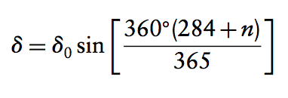
Geometry of Earth and Sun
Hour angle at P is the angle through which the Earth has rotated since solar noon. Since the Earth rotates at 360/24h = 15 h⁻¹, the hour angle is given by
The angle between the Sun’s direction and the equatorial plane is called the declination angle , relating to seasonal changes.

Slide 42
Geometry of Earth and Sun

Slide 43
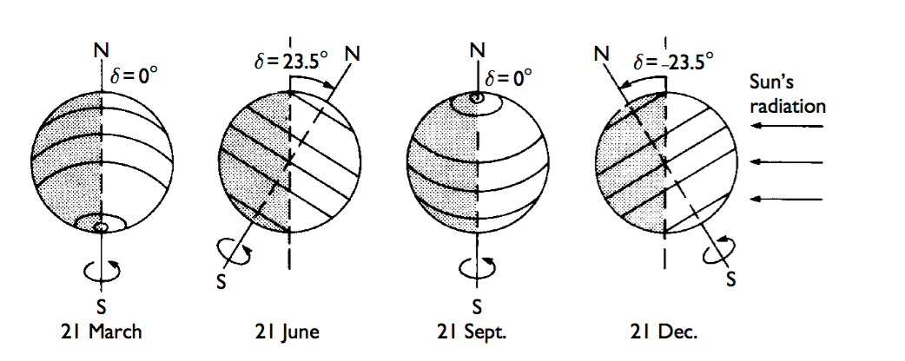
Geometry of Earth and Sun
The Earth, as seen from a point further along its orbit. Circles of latitude 0º,±23.5º,±66.5º are shown. Note how the declination δ varies through the year, equaling extremes at the two solstices and zero when the midday Sun is overhead at the equator for the two equinoxes (equal day and night on the equator).

Slide 44
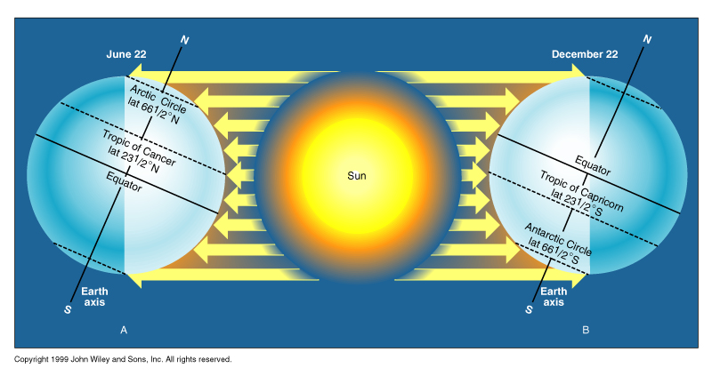
Geometry of Earth and Sun
The seasons occur because the tilt of the Earth's axis keeps a constant orientation as the Earth revolves around the Sun. A. Summer in northern hemisphere. B. Winter in southern hemisphere

Slide 45
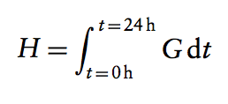
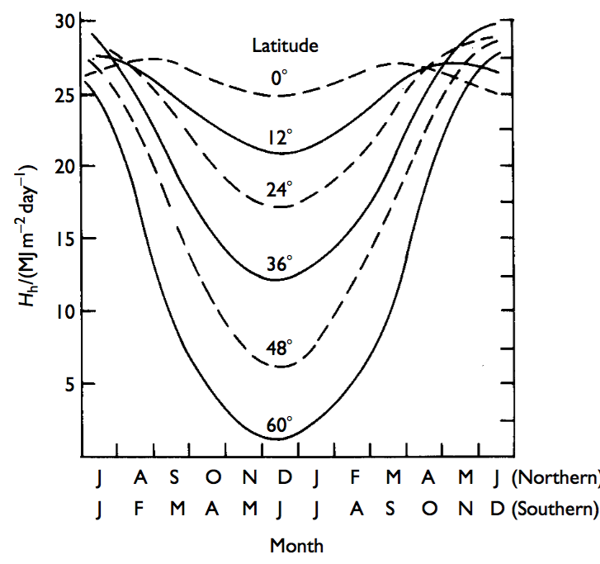
Geometry of Earth and Sun
Daily insolation H is the total energy per unit area received in one day from the sun:
Three key reasons for variation are:
Variation in length of the day

Slide 46
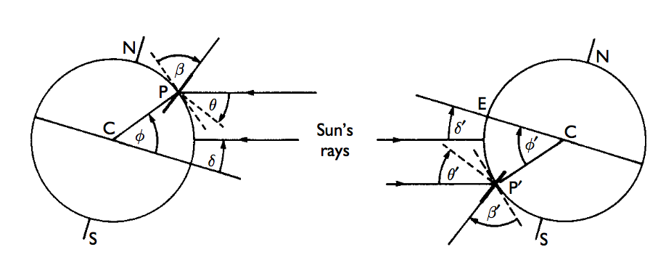
Geometry of Earth and Sun
Orientation of the receiving surface
Variation in atmospheric absorption

Slide 47
Questions?

